Slide 1


Introduction to the Linux Commandline

Slide 2
The commandline is...
fast
well documented
(almost) universal
powerful and flexible

Slide 3
But beware...
test before run
the environment
case sensitivity
the filesystem

Slide 4
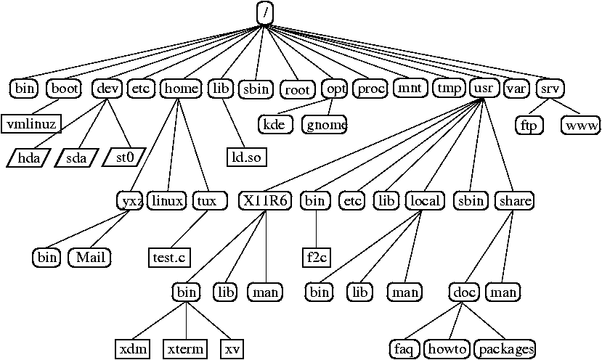

Slide 5
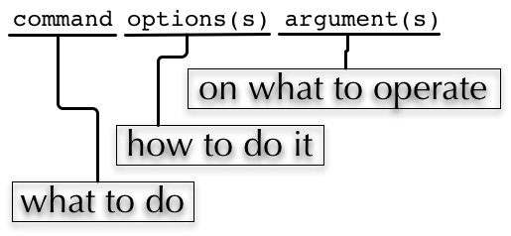
“Anatomy” of a commandline

Slide 6
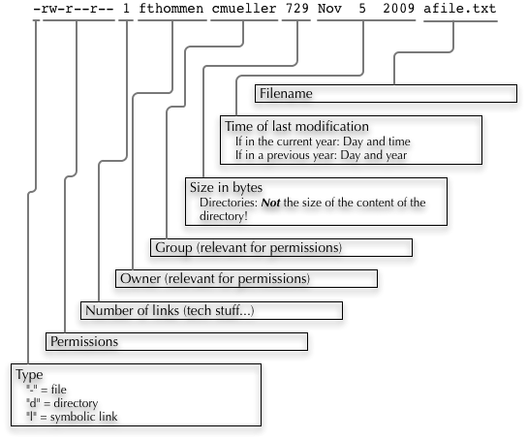
loooong listing

